Slide 1
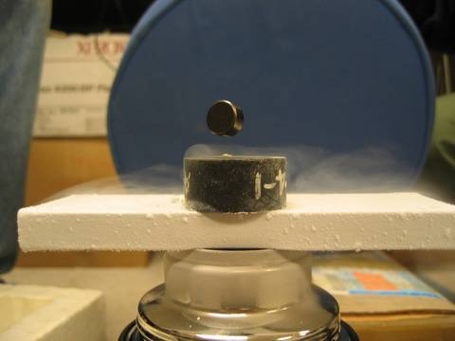
Vortex structure in Type-II Superconductors
-- PHYS. 580 Course Project
Yikai Yang
M. Peck/Cornell Univ.

Slide 2
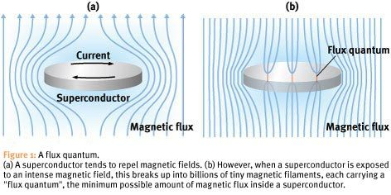
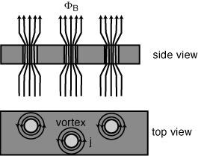
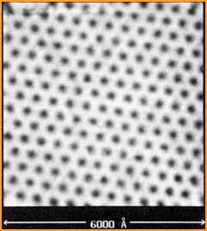
F. Nori. Riken Research 2, 6(2007).
P. Holfmann. Online material
H. F. Hess et al. Phys. Rev. Lett. 62, 214(1989)

Slide 3
Background
Ginzburg-Landau Theory
Less technical than microscopic theory (BCS theory).
based on Landau’s second order phase transition theory.
Developed by Abrikosov
Analytically solved with a brilliant guess of an
exact solution.
A degenerate state, can take different symmetries.

Slide 4
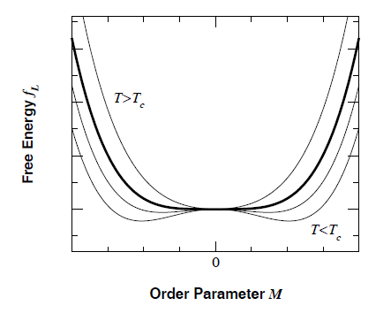
Theoretical basis
Free energy
[1] P.D. Olmsted. Lectures on Landau Theory of Phase Transition.

Slide 5
Use variation principle:

Slide 6
Further simplification
Unit choice:
Dimensionless wavefunction:
Variable substitution:

Slide 7
Gauge choice:
Coulomb Gauge:
London Gauge:
Landau Gauge:
“Unknow” Gauge[2]:
[2] M.Tinkham, Introduction to Superconductivity(2nd). McGraw-Hill (1996).

Slide 8
New look (GL-1):
GL-2:

Slide 9
Numerical implementation (relaxation method)
(Complex)
scaler field
+ Vector field
GL-1[3,4]:
Transformation:
[3] P.S. Deo, et al. Phys. Rev. Lett. 79, 23 (1997).
[4] V.A.Schweigert, et al. Phys. Rev. Lett. 81, 13. (1998)

Slide 10
GL-2(vector field):
Apply
Implement :

Slide 11
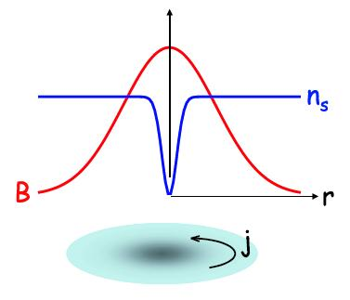
Discretizing:
spatial step must be sufficiently smaller than
the coherent length ( ).
adaptive to the variation of solution.
adaptive to the geometry of system.

Slide 12
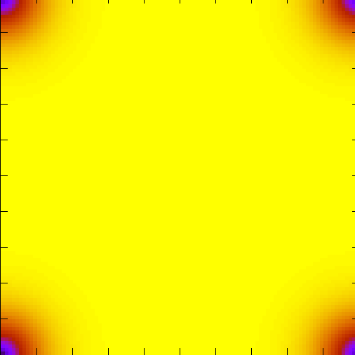
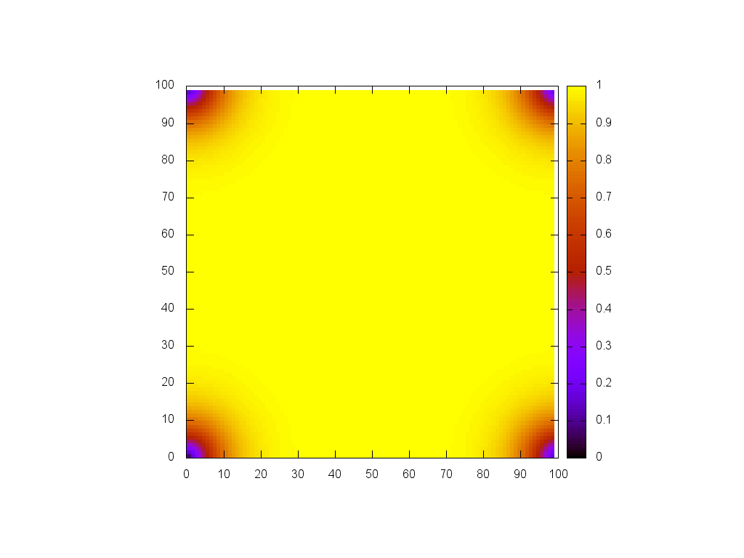
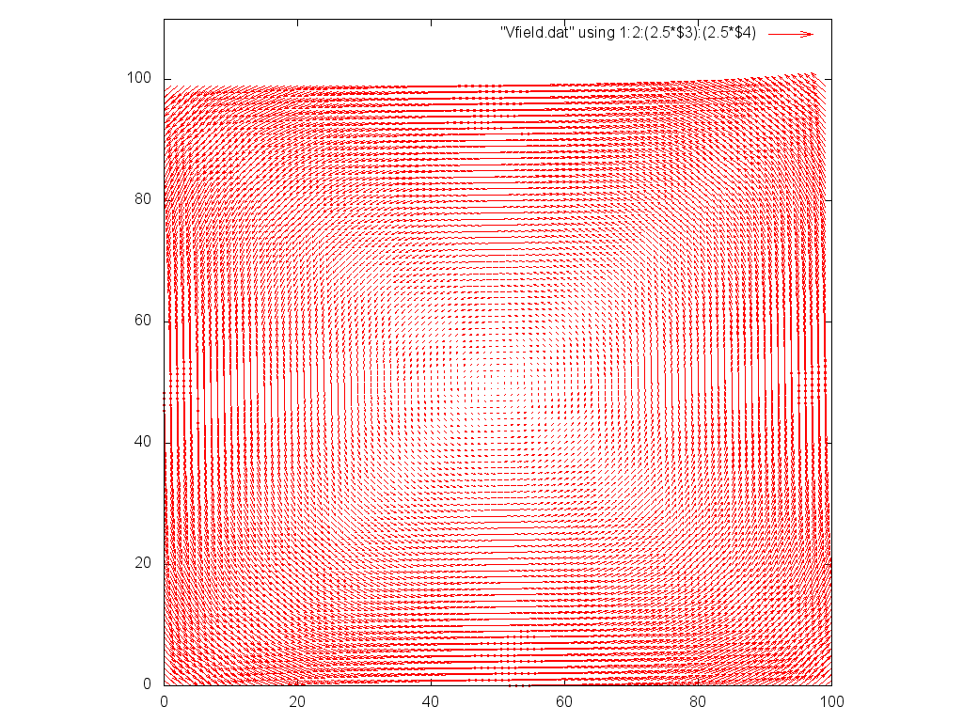
Boundary Condition
Start with: infinitely large, periodic condition
1st icing layer: Finite size, square shape.
2nd icing layer: Finite size, circular shape.
3rd icing layer: Finite size, 3 dimension,
circular shape.
… …

Slide 13
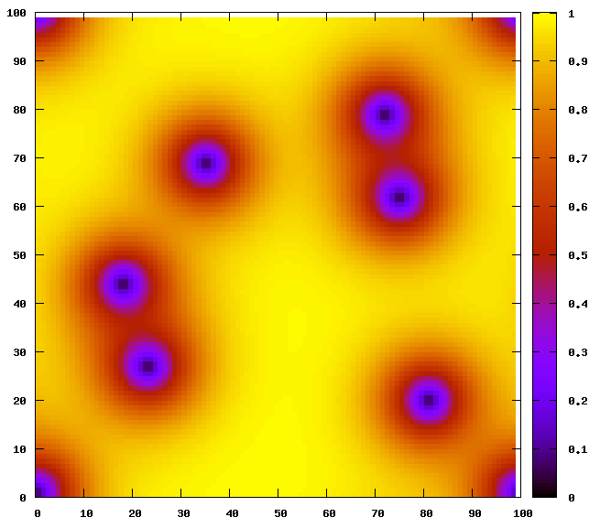
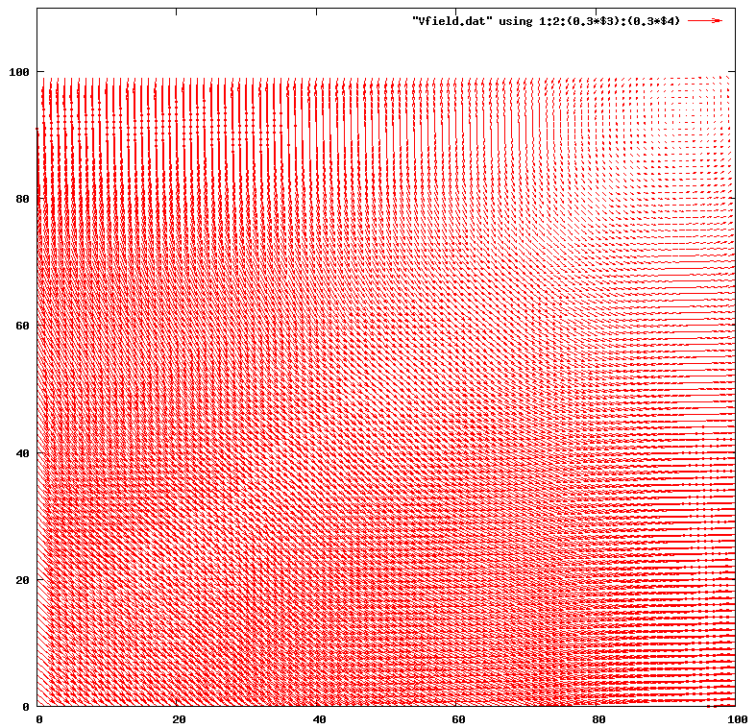
Initial Condition
Randomly generate vortices in the sample with randomly chosen position.
Initialize corresponding vector potential.

Slide 14
Summary

Slide 15
Summary
Orally...

Slide 16
Thank you!

